Slide 1
Data Binding
Data binding in detail
Two-way binding
Decisions and iteration
Additional techniques
Demo app: AngularDev/Demos/03-DataBinding/DemoApp
To install: npm install
To run: ng serve

Slide 2
Section 1: Data Binding in Detail
Example application
TypeScript code
Data binding syntax
Binding to computed values
Binding target properties
Binding events
Safe navigation

Slide 3
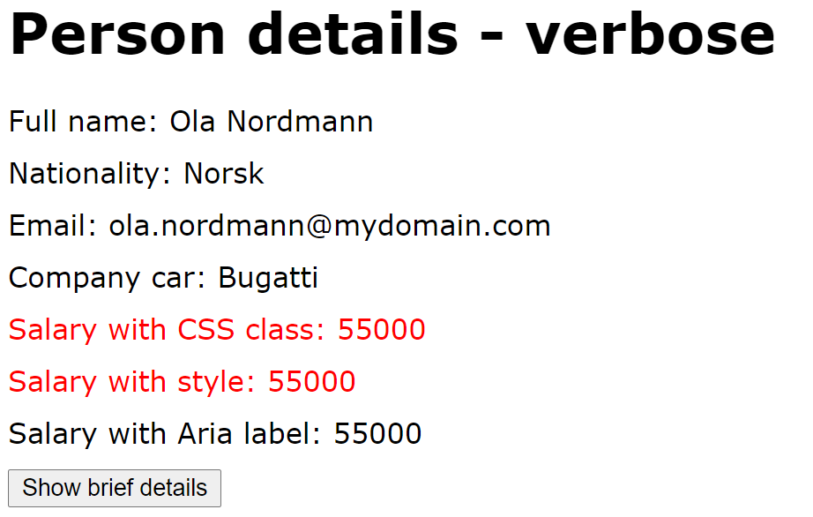
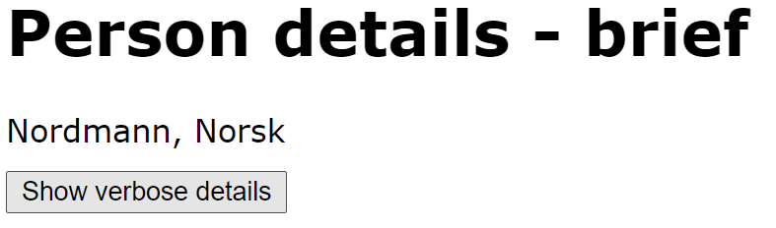
Example Application
In this section we dig deeper into data binding syntax
In the demo app, click the Data binding syntax link
Click the button to toggle between verbose / brief modes
Notice the button label changes when you click it
3

Slide 4
TypeScript Code
Here's the partial TypeScript code (discussions follow…)
@Component({…})
export class DataBindingSyntaxComponent {
firstName: string;
lastName: string;
nationality: string;
emailAddress: string;
companyCar?: Car;
salary: number;
verbose: boolean;
…
label() {
return (this.verbose) ? 'Show brief details' : 'Show verbose details';
}
onVerboseToggle(event: any) {
this.verbose = !this.verbose;
}
}
data-binding-syntax.component.ts
4

Slide 5
Data Binding Syntax
Here's a recap of simple data binding using {{ }}
The expressions bind to these component properties:
<h1>Person details - verbose</h1>
<div>Full name: {{firstName}} {{lastName}} </div>
<div>Nationality: {{nationality}} </div>
<div>Email: {{emailAddress}} </div>
…
data-binding-syntax.component.html
export class DataBindingSyntaxComponent {
firstName: string;
lastName: string;
nationality: string;
emailAddress: string;
…
}
data-binding-syntax.component.ts
5

Slide 6
Binding to Computed Values
You can bind to computed values within the {{ }}
E.g. call a function that returns a value dynamically
Template expressions shouldn't change any application state, except the value of the target property
<button (click)="onVerboseToggle($event)"> {{label()}} </button>
export class DataBindingSyntaxComponent {
…
label() {
return (this.verbose) ? 'Show brief details' : 'Show verbose details';
}
}
6

Slide 7
Binding Target Properties
You can bind target properties on an element
Enclose property name in []
<div [hidden]='!verbose'>
<h1>Person details - verbose</h1>
<div>Full name: {{firstName}} {{lastName}} </div>
<div>Nationality: {{nationality}} </div>
…
</div>
<div [hidden]='verbose'>
<h1>Person details - brief</h1>
<div>{{lastName}}, {{nationality}} </div>
</div>
export class DataBindingSyntaxComponent {
…
verbose: boolean;
}
7

Slide 8
Binding Events
You can bind an event to a function in the component
Enclose event name in ()
Call handler function, and pass argument(s) if you like
<button (click)="onVerboseToggle($event)"> {{label()}} </button>
export class DataBindingSyntaxComponent {
…
onVerboseToggle(event: any) {
this.verbose = !this.verbose;
}
}
8

Slide 9
Safe Navigation
The safe navigation operator ?. is very useful
Means the field is optional
If field is undefined, rest of expression is ignored
<div>Company car: {{companyCar?.make}}</div>
9

Slide 10
Section 2: Two-Way Data Binding
1-way data binding - recap
2-way data binding
Delaying data binding until "done"
2-way data binding example
Supporting 2-way data binding

Slide 11
1-Way Data Binding - Recap
[] syntax gives 1-way binding
Binds component model to UI property
() syntax gives 1-way binding in the other direction
Binds UI event to component event handler
<div [hidden]="verbose">
…
</div>
<button (click)="onVerboseToggle()">
…
</button>
11

Slide 12
2-Way Data Binding
[()] syntax gives 2-way binding
Binds component model to UI, to display data
Binds UI to component, to update data in model
Alternatively you can use two separate 1-way bindings
[xxx] binds component model to UI
(xxxChange) binds UI to component
<input type='number' [(ngModel)]="salary">
<input type='number' [ngModel]="salary" (ngModelChange)="salary=$event">
12

Slide 13
Delaying Data Binding Until "Done"
Sometimes you want to delay updating the model value until the user has tabbed out of a text box
E.g. a numeric field, don’t update model after each digit
To achieve this, handle the blur or change events
Upon the event, update the model with the UI value
<input type='number' [value]="salary" (change)="onSalaryChange($event)">
export class DataBindingSyntaxComponent {
…
onSalaryChange($event) {
this.salary = Number($event.target.value);
}
}
13

Slide 14
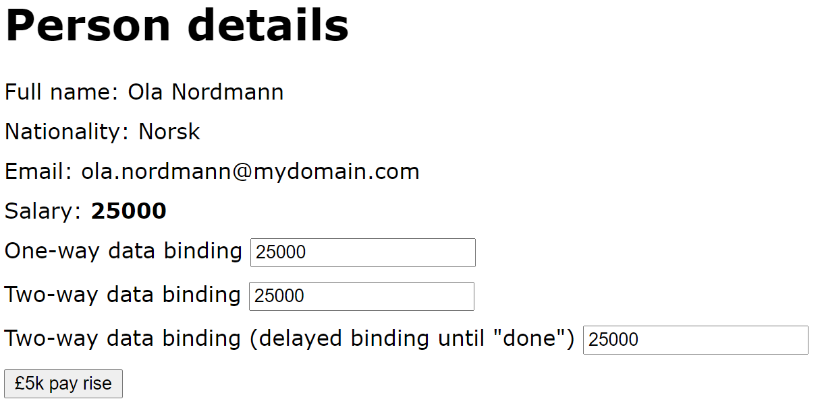
2-Way Data Binding Example (1 of 2)
Let's see an example of 2-way data binding
In the demo app, click the 2-way data binding link
There are two text boxes, where you can change salary
There's also a button, which gives a £5k pay rise
14

Slide 15
2-Way Data Binding Example (2 of 2)
Here are the relevant parts of the HTML and code:
Salary: <b> {{salary}} </b>
One-way data binding <input type='number' [value] = "salary">
Two-way data binding <input type='number' [(ngModel)] = "salary">
Two-way data binding (delayed binding until "done")
<input type='number' [value]="salary" (change)="onSalaryChange($event)">
<button (click)="payRise()">Pay rise</button>
two-way-binding.component.html
export class TwoWayBindingComponent {
salary: number;
…
payRise() {
this.salary = this.salary + 5000;
}
onSalaryChange($event) {
this.salary = Number($event.target.value);
}
two-way-binding.component.ts
15

Slide 16
Supporting 2-Way Data Binding (1 of 2)
Your app dependencies must specify Angular Forms
Angular CLI does this for you - see package.json
"dependencies": {
"@angular/forms": "~14.1.0",
…
}
package.json
16

Slide 17
Supporting 2-Way Data Binding (2 of 2)
Your app module must include FormsModule
You must modify app.module.ts as follows:
import { FormsModule } from '@angular/forms';
…
@NgModule({
declarations: […],
imports: [FormsModule, BrowserModule, AppRoutingModule],
providers: [],
bootstrap: [AppComponent]
})
export class AppModule {}
app.module.ts
17

Slide 18
Section 3: Decisions and Iteration
Overview
If tests
If-then-else tests
For loops
Switches

Slide 19
Overview
Angular has structural directives that allow you to make decisions and to do iteration in your HTML template
ngIf - conditional rendering
ngFor - iterative rendering
ngSwitch - branch-based rendering
Aside:
In Angular terminology, a structural directive is a class that changes the DOM by adding/removing elements
19

Slide 20
If Tests (1 of 2)
You can use ngIf to perform a test
Use the ngIf directive, prefixed with *
Angular embeds content in an <ng-template> tag
Angular activates <ng-template> tag conditionally
<div *ngIf="salary > 40000" style="color:red">
[Upper tax payable on {{salary - 40000}}]
</div>
ng-if.component.html
20

Slide 21
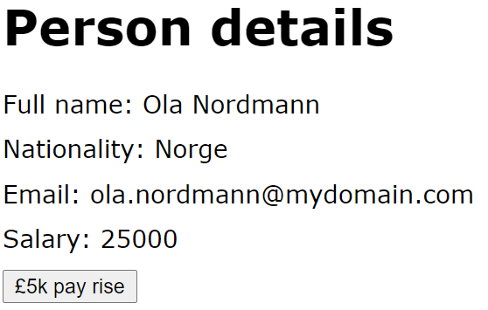
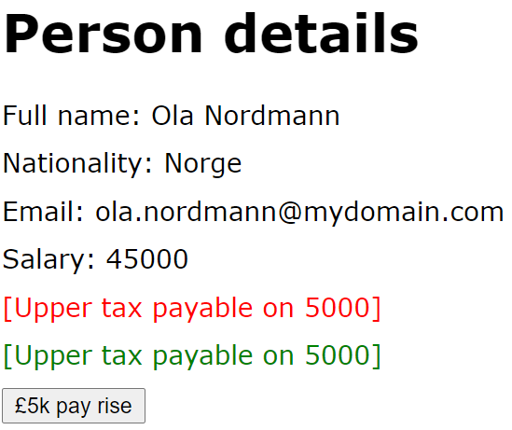
If Tests (2 of 2)
Let's see an example of ngIf tests
In the demo app, click the ngIf link
Initial display
After several pay rises
21

Slide 22
If-Then-Else Tests (1 of 3)
ngIf can specify a then clause
Lets you define the <ng-template> tag separately
Use # to give the <ng-template> tag a name
<div *ngIf="salary > 40000; then hiTaxTemplate1"></div>
<ng-template #hiTaxTemplate1> … </ng-template>
ng-if-then-else.component.html
22

Slide 23
If-Then-Else Tests (2 of 3)
ngIf can also specify an else clause
Specify names of true/false <ng-template> tags
<div *ngIf="salary > 40000; then hiTaxTemplate2 else loTaxTemplate"></div>
<ng-template #hiTaxTemplate2> … </ng-template>
<ng-template #loTaxTemplate> … </ng-template>
ng-if-then-else.component.html
23

Slide 24
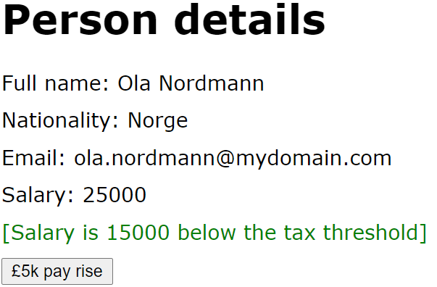
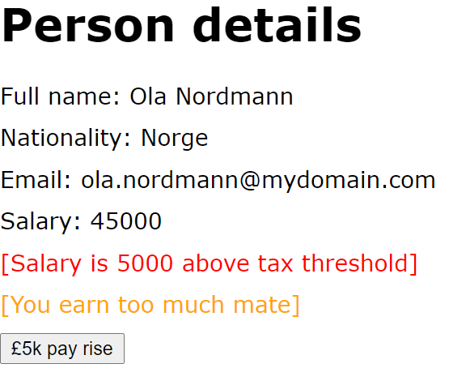
If-Then-Else Tests (3 of 3)
Let's see an example of if-then-else tests
In the demo app, click the ngIf-then-else link
Initial display
After several pay rises
24

Slide 25
For Loops (1 of 2)
You can use ngFor to iterate over a collection
Specify the collection you want to iterate over
Angular clones the element for each collection item
<ul>
<li *ngFor="let s of skills; let i=index">
[Skill {{i+1}}] {{s}}
</li>
</ul>
ngFor exposes several useful variables:
index, first, last, even, odd
ng-for.component.ts
25

Slide 26
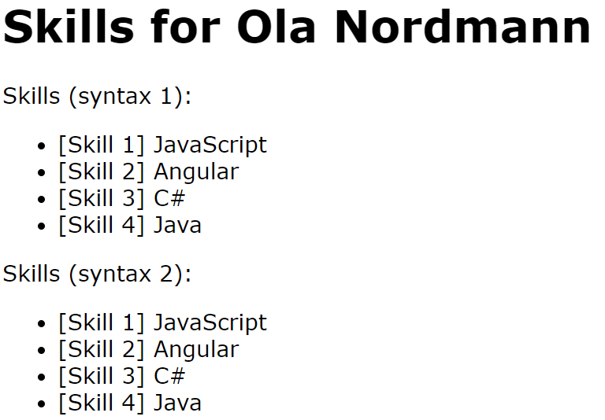
For Loops (2 of 2)
Let's see an example of ngFor loops
In the demo app, click the ngFor link
26

Slide 27
Switches (1 of 2)
You can use ngSwitch for multi-way branching
Use ngSwitchCase for each branch
Use ngSwitchDefault for default branch (optional)
<span [ngSwitch]="nationality">
<span *ngSwitchCase="'Norge'">Norway</span>
<span *ngSwitchCase="'UK'">UK</span>
<span *ngSwitchDefault>[Other country]</span>
</span>
ng-switch.component.ts
27

Slide 28
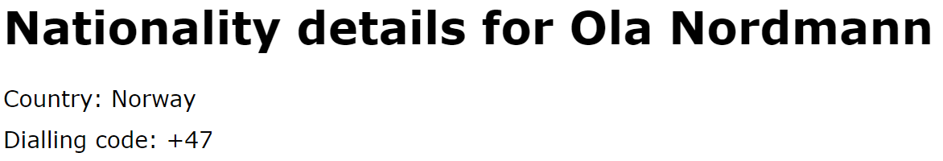
Switches (2 of 2)
Let's see an example of ngSwitch branching
In the demo app, click the ngSwitch link
28

Slide 29
Summary
Data binding in detail
Two-way binding
Decisions and iteration

Slide 30
Annex: Additional Techniques
Data binding CSS classes and styles
Key binding and template variables

Slide 31
Data Binding CSS Classes and Styles
You can data bind a CSS class
Set [class.aClass] to a binding expression
If binding expression is truthy, CSS class is applied
You can data bind a CSS style
Set [style.aStyle] to a binding expression
The binding expression specifies the style value
<div [class.emphasis]="salary >= 40000">Salary {{salary}}</div>
<div [style.color]="salary >= 40000 ? 'red': 'green'">Salary {{salary}}</div>
31

Slide 32
Key Binding and Template Variables
Key binding
The keyup event ordinarily triggers on every keystroke
You can use the keyup.enter pseudo-event to target just the Enter keystroke
Template variables
You can declare a template variable to represent an element, via the syntax "#templateVarName"
Allows you to access the element easily elsewhere
32

Slide 33
Key Binding and Template Variables
In the demo app, click the Additional techniques link
Here's the relevant HTML and code
<h1>Skills for {{name}}</h1>
<input #newSkill (keyup.enter)="addSkill(newSkill)">
<button (click)="addSkill(newSkill)">Add</button>
<p>{{skills}}</p>
additional-techniques.component.html
export class AdditionalTechniquesComponent {
name = "Kari Nordmann";
skills = "";
addSkill(newSkill: HTMLInputElement) {
this.skills += newSkill.value + " ";
newSkill.value = "";
newSkill.focus();
}
}
additional-techniques.component.ts
33

